Slide 1
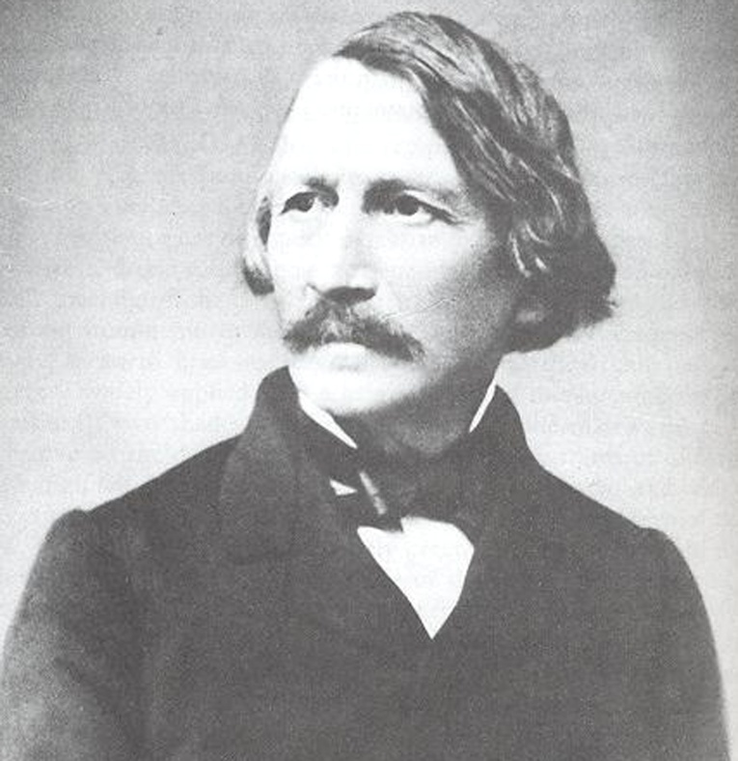
Gottfried Semper
1803 – 1879
Began his professional career as a mathematician.
Introduced to architecture by Franz Christian Gau and
Jaques Ignace Hittorff
-Began work in Dresden, Germany
-Took part in Dresden uprising -1849
-Published The Four Elements of Architecture in 1851
Leading architectural theorist of nineteenth century on
polychromy and polychromy in antiquity
-Later worked In Zurich, Switzerland and Vienna, Austria
Polychrome- term to describe the use of multiple colors in one entity. Most often used in conjunction with styles of architecture.
1855

Slide 2
The Four Elements of Architecture A Contribution to the comparative study of Architecture
-Ideas based on influences from Hittorff
-Defends previous publications that were taken out of context (Kugler’s book)
-Stresses the importance of review in all styles and periods of architecture polychrome
-Believed paint was used on classical buildings as a protective material (Greek, Etruscan, Egyptian)
-There is proof that paint still exists on these buildings
-Statues from all cultures were polychromatic instead of their current monochrome appearance
-Color had symbolic associations
-Color is an expression of artistic freedom
Material | Clay | Wood | Textile | Stone
Technique | Ceramics | Carpentry | Weaving | Masonry
Basic Elements | Hearth | Roof | Enclosure | Substructure

Slide 3
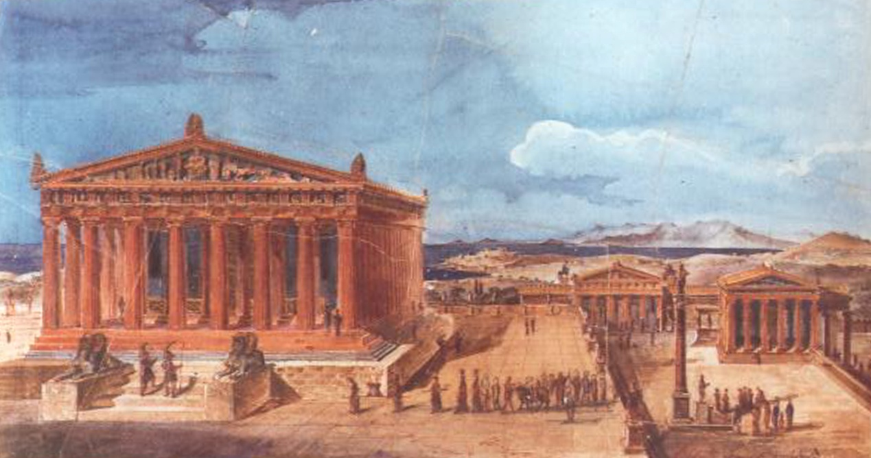
Views of the Acropolis in Athens Gottfried Semper
These are colored depictions from Semper’s early travels around Europe. Details that are depicted come from Semper’s own investigations around the temples.

Slide 4
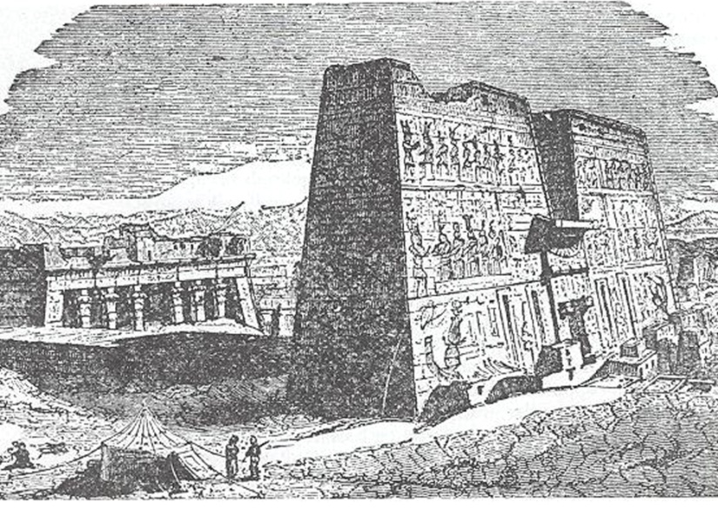
Arguments for Polychrome Antiquity
The Chemical Proof
-References his brochure that was cited by Kugler
-References the reports of other archeologist and architects about the Acropolis
-Very thorough in presenting evidence
-Compares Greek Acropolis to other Egyptian and Etruscan temples to add proof to polychromy in antiquity
Temple of Thesus / Ceiling Panel
b) Sky blue c)Undeterminable d)Terra-cotta
e)Thin coating of paint or gold on enamel base
Egyptian Temple of Edifu

Slide 5
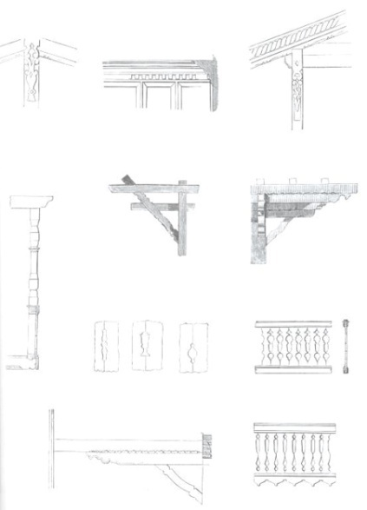
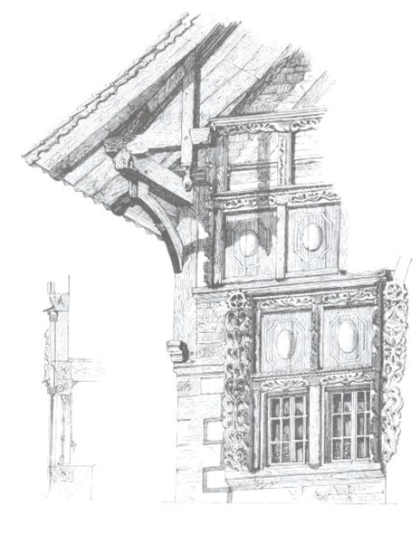
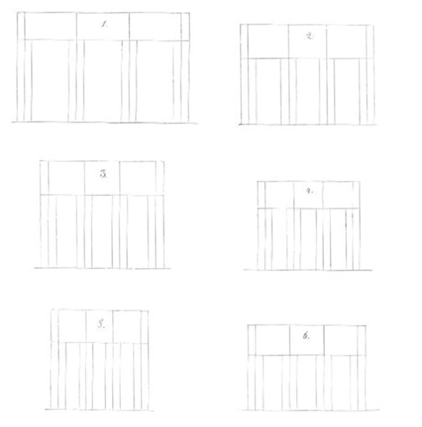
Other Publications
1852 - Science, Industry, and Art (Proposals for the Development of a National Taste in Art at the closing of the London Industrial Exhibition)
-Talks about the necessity of inventions and the advancement of arts and sciences.
1852 - Comparative Theory of Building
-Reviews all building types, their locations, methods of building, and histories thereof
1859 - Style in the Technical and Tectonic Arts or Practical Aesthetics
-Discusses extensively the use of materials within arts, crafts, and architecture. Reviews the detail involved in the tectonic arts. Analyses architectonics in antiquity and current architecture. Provides mathematical formulas to categorize different styles.

Slide 6
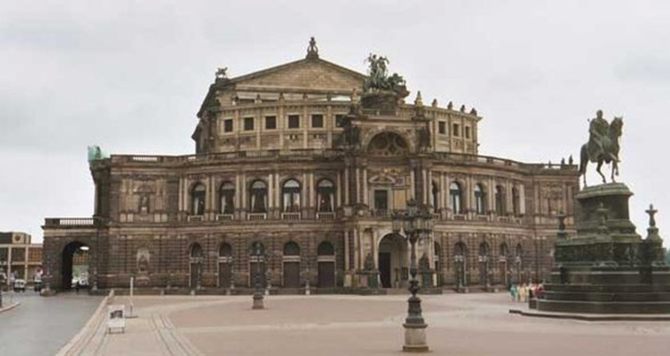
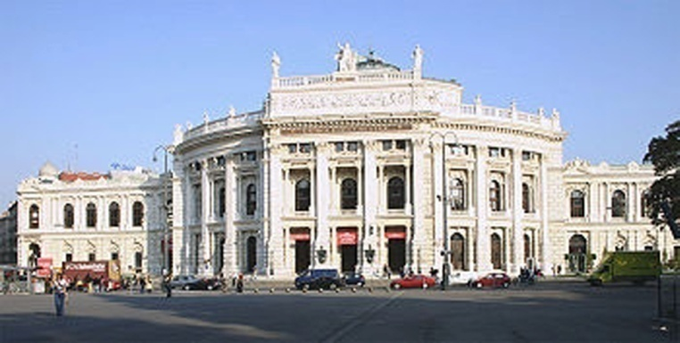
Works in Architecture
Dresden
-Hoftheater -1841 (destroyed by fire in 1869)
-Villa Rosa -1839 (destroyed in WWII)
-Semper Synagogue -1838 (destroyed during Kristallnacht 1938)
-Oppenheim Palace -1848
-Painting Galery -1848
-Neues Hoftheater (Semeperoper) -1878
Zurich
-Polytechnical School (ETH Zurcih) -1864
-Observatory -1864
Winterthur
-City Hall – 1864
Vienna
-Municipal Theater -1888
-Museum of Art History -1889
-Natural History Museum -1891
Semperoper
Municipal Theater, Vienna

